Slide 1
Present-Infrastructure building
FAMILY PARTNERSHIPS
HIGH SCHOOL INFORMATION
FOR 8TH GRADE FAMILIES

Slide 2
Families Are Important for Student Success

Slide 3
Family Engagement Is Critical Throughout High School

Slide 4
“This is the year that will set the stage for whether high school students will graduate and whether they will be ready for college.”
Chicago Consortium on School Research, 2007

Slide 5
Ninth Grade Course Performance Predicts
Probability of On-Time Graduation
Percentage of Students Graduating on Time,
by Number of 9th Grade Core Course Failures
Probability of graduating decreases with each 9th grade course failure.

Slide 7
Research shows that high school efforts to engage families PAY OFF in improved student outcomes.

Slide 8
What student outcomes are most important?
Making sure student pass all 9th grade courses to stay on-track in earning course credits needed for graduation
Improving students’ learning and grades overall so they are college-ready

Slide 9
Regular attendance is critical to make sure students pass their courses!

Slide 10
Attendance Matters!
What happens when a student misses a day in high school?
Student needs to find a way to:
Show paperwork to all teachers to get absence excused
Learn the material missed in all classes
Make up the assignments missed in all classes
Keep up with the current work while making up the missed work
It is very easy to fall behind.
When you fall behind, your grades are likely to slip.
Missing too many days of class may mean that the student does not receive a passing grade.

Slide 11
How parents can help increase student success:
Make sure your teen is doing homework every night.
Set goals with your teen and ask them about their progress.
Encourage your teen to ask their teachers for help as needed.
Make sure you know the grading policies for each of your student’s teachers.
Encourage your student’s teachers and counselors to contact you if your student’s grades fall below a “C.”

Slide 12
Learn How to Use the Parent Portal To Check on Student Grades and Homework

Slide 13
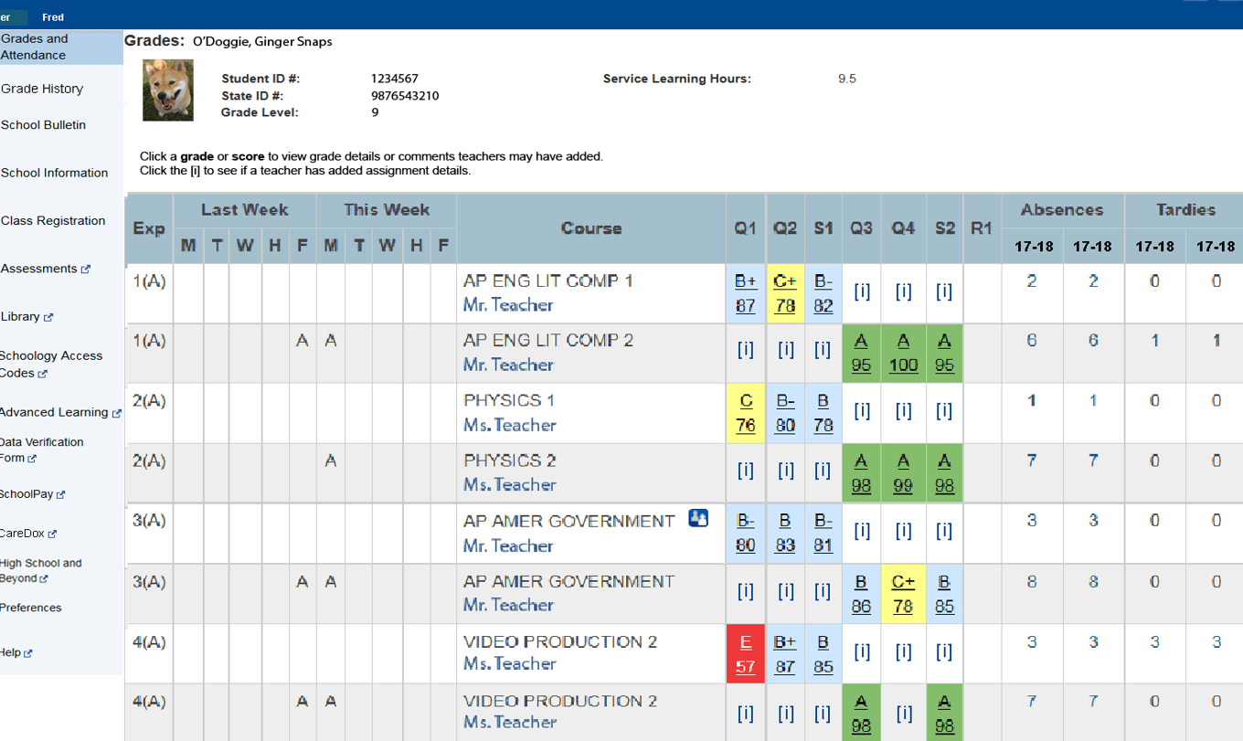
Studies suggest that regular parent use of the parent portal can help monitor students’ coursework thereby improve course passing rates.
Stay tuned for more information on the parent portal later in the presentation.

Slide 14
Talk with your teen regularly about their goals for after high school and what steps they need to take to meet those goals.

Slide 15
Other Important Things to Know

Slide 16
Graduation Requirements
Notes:
4:40
As a reminder, this change in state law provided the original impetus for these discussions.

Slide 17
Important Contact Information (Pick Up Your Refrigerator Magnet in Spanish or English)

Slide 18
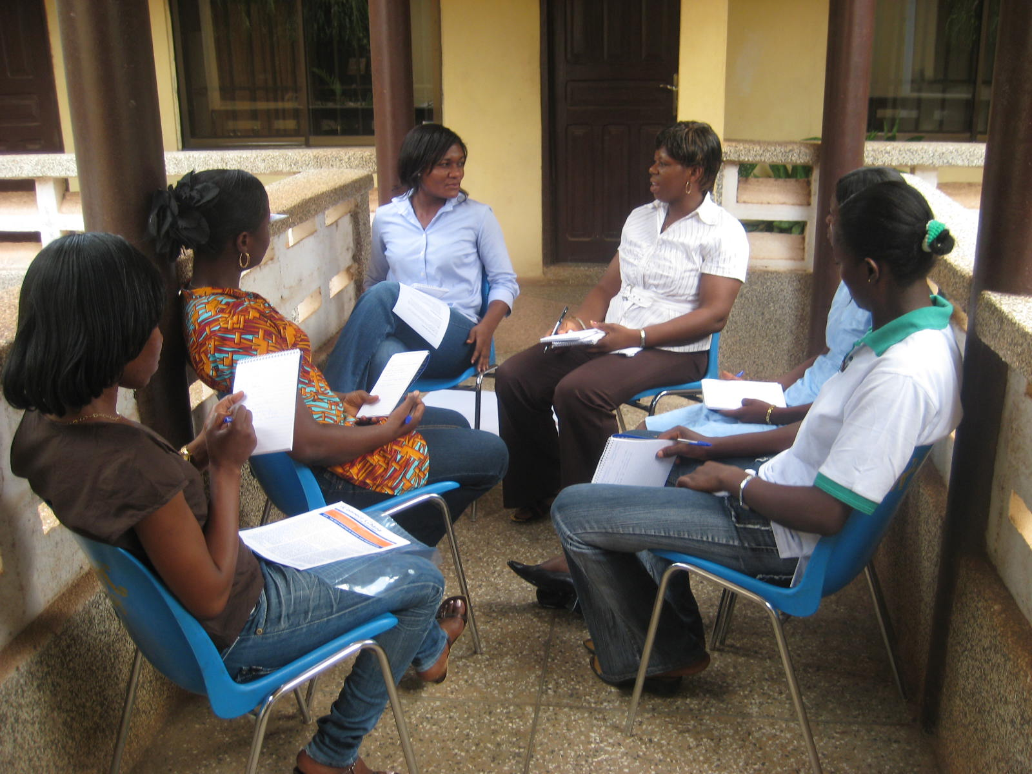
Let school staff hear what you are thinking – they need to hear parent and student voices

Slide 19
Add slides with instructions on using the parent portal at this point if desired (see example in posted materials)

Slide 20
The creation of this presentation was supported by the Institute of Education Sciences, U.S. Department of Education, through Grant R305H150081 to Johns Hopkins University. The opinions expressed are those of the authors and do not represent views of the Institute or the U.S. Department of Education

