Slide 1

Attendance Matters!
What happens when a student misses a day in high school?
Student needs to find a way to:
  Show paperwork to all teachers to get absence excused
  Learn the material missed in all classes
  Make up the assignments missed in all classes
  Keep up with the current work while making up the missed work
It is very easy to fall behind.
When you fall behind, your grades are likely to slip.
Missing too many days of class may mean that the student does not receive a passing grade.

Slide 2

How parents can help increase student success:
Make sure your teen is doing homework every night.
Set goals with your teen and ask them about their progress.
Encourage your teen to ask their teachers for help as needed.
Make sure you know the grading policies for each of your student’s teachers.
Encourage your student’s teachers and counselors to contact you if your student’s grades fall below a “C.”

Slide 3

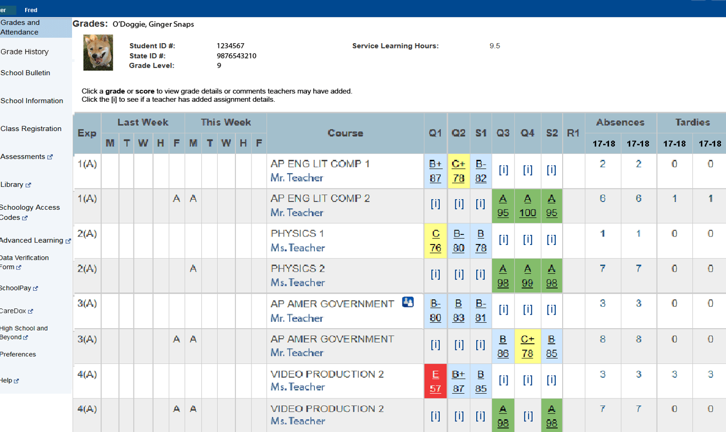
Learn How to Use the Parent Portal To Check on Student Grades and Homework

Slide 4


Talk with your teen regularly about their goals for after high school and what steps they need to take to meet those goals.

Slide 5



Let school staff hear what you are thinking – they need to hear parent and student voices

