Slide 1


Engaging Families During the Transition to
High School
Fall Institute

Slide 2
Welcome and Introductions

Slide 3
What Does Family Engagement Look Like?
Icebreaker

Slide 4

As you watch the short video clip, think about the ways you see families being engaged (see translation below).
Then use markers or write on post-its to share words, phrases, or images of what great family engagement looks like on the poster sheets around the room.
This Photo by Unknown Author is licensed under CC BY

Slide 5

Translation (from Spanish) of Middle School Family Engagement Video (https://vimeo.com/144885310)
1st Mother speaking – I want my kids to attend University and choose a career where they can make more money than me who is always short of money earning very little, worrying every day. An education is the only inheritance I can leave them for their future.
2nd Mother speaking - It is important to attend this meetings and classes for families. I am very happy with all they taught us. We learned about options and how we can help our kids.
3rd Mother speaking (same as #1) – I thank (school name) for this opportunity to learn. I wish all parents knew that it is important to attend for the future of their children.
This Photo by Unknown Author is licensed under CC BY

Slide 6
Keeping the
Goal in Mind
The Goal of
Family Engagement:
To help all students succeed

Slide 7


“This is the year that will set the stage for whether high school students will graduate and whether they will be ready for college.”
Chicago Consortium on School Research, 2007

Slide 8
Top Predictors of On-Time
College-Ready Graduation
9th Grade Course Performance
9th Grade Attendance

Slide 9
8th Grade Matters Too!
8th Grade Attendance and Course Grades Are Important Predictors of 9th Grade Outcomes
Lots of students DECLINE on these measures between 8th and 9th grade.
Few students improve between 8th and 9th grade.

Slide 10


School efforts
to engage families
in the transition to high school
are crucial for
eliminating the opportunity gap.

Slide 11
Questions to
Consider
What malleable school factors
(school climate, teacher practices, etc.)
are related to differences in attendance and course performance?

Slide 12
Questions to
Consider
How can school efforts in family engagement support families in ways that lead to improvements in attendance and course performance?

Slide 13
School teams each receive copy of their chronic absence and course failure rates over past three years.
REFLECTION QUESTIONS FOR TEAMS:
What steps are you taking to decrease chronic absence and course failure?
How can you support families to help support their students in these areas?
Time to Reflect on Our Own School Data

Slide 14

Best Practices in Secondary Family Engagement
School and Parent Panel
Q & A

Slide 15
Sending Parents
Useful Information
Discussion of Article

Slide 16

Discussion Questions on “Sending Parents Useful Information”
What do you think about Rogers’ statement:
Parents get so little information and so little of what they get is useful.
Is this a fair statement? Why or why not?
What information do your families receive about the transition to high school?
What additional information might they need in order to successfully support their students?
For example, how well do you think families understand the consequences of missing a day in high school and all the things that need to happen for the student to be able to recover the learning and assignments for the day? What additional information might schools need to make available, in multiple formats, to assist families regarding this issue?

Slide 17

More Discussion Questions on “Sending Parents Useful Information”
What do you think about the idea of sending parents mailings about attendance? Do you think it could have the same level of impact at your school as was found in the research studies?
What do you think about the argument made in the article about giving parents information on-line?
How could you implement the texting of parents advocated in this article?
What next steps could you take as a school team in light of your learning from this article?

Slide 18

Smoothing the Transition to High School
Video Clip and Discussion
https://www.youtube.com/watch?v=k_j7NsEX0p0

Slide 19
Smoothing the Transition to High School
As you watch this video clip, think about the following questions. You will have time to discuss these in your small groups after the video.
What issues related to student success in high school are emphasized? How is family support important in addressing these issues?
What support do families need to help them support their students?
How can the district and schools help support families to effectively support their students?
How might this video be useful to show to parents and students during a transition-focused event? What kinds of conversations could it evoke? What planning would be necessary to increase the effectiveness of the video as a tool to use with families and students?

Slide 20
LUNCH

Slide 21
A Continuous Improvement Approach to Family Engagement

Slide 22
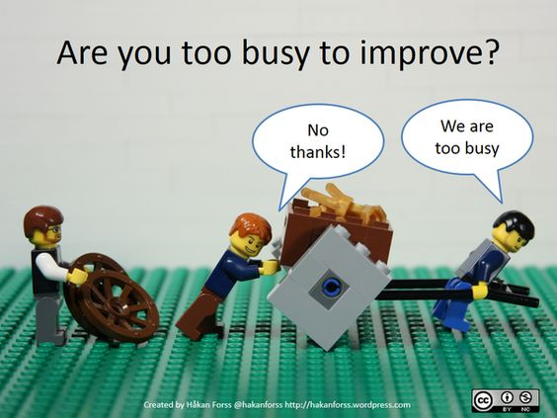
https://www.pinterest.com/pin/551268810610926516/

Slide 23
The Importance of Reflection for Improvement
Teaching involves such a complex set of skills that lessons are almost never perfect. The key to being an accomplished teacher is acquiring the skill to continually improve one’s practice; an important vehicle for this is reflection and conversation.
Charlotte Danielson

Slide 24
Family Engagement is another key education practice that needs continuous improvement.
Reflection is an essential component of the process.

Slide 25
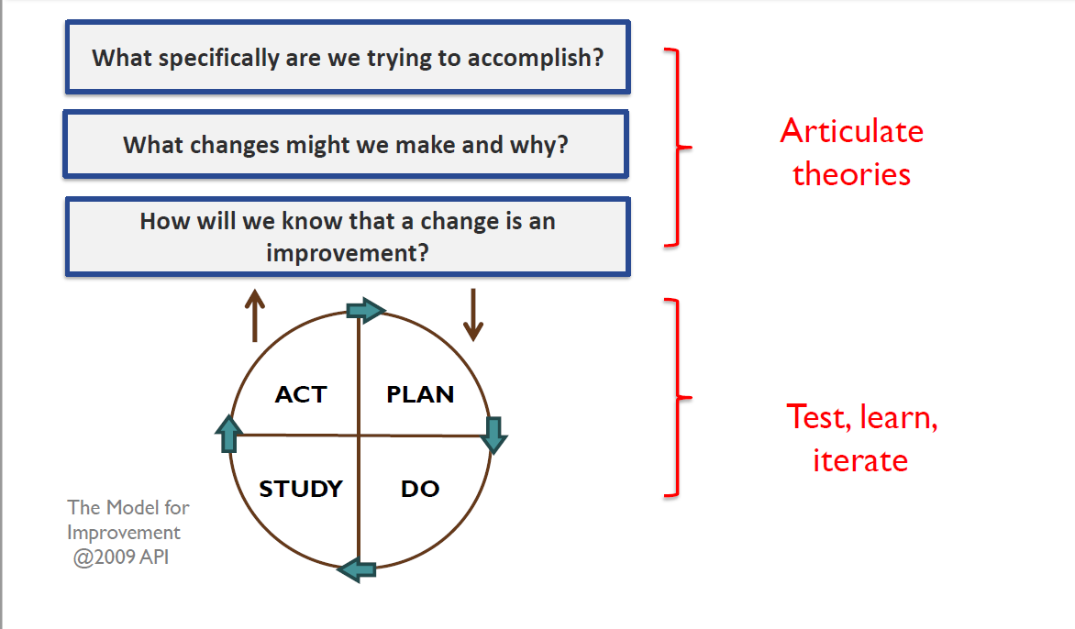
Cycle of Inquiry
A Framework for Continuous Improvement
Cycle
of
Inquiry
Notes:
A key foundation of understanding of my presentation is a general understanding of the Cycle of Inquiry Process: this is consistent with the AWSP, Danielson, and Keeping our Promise Action Plan which cycles of inquiry require a disciplined approach to thinking, questioning, and acting all of which is consistent with the Keeping our Promise Action Plan (explicit connections to what we are already doing, learning).
In relation to the Promise Action Plan, Cycles of Inquiry work is aligned to creating a systemic approach to aligning gap closing strategies into an effective, coherent, system-wide approach (the case for urgent action). A cycle of inquiry approach to adult learning centered on outcomes for all students, specifically traditionally marginalized and underperforming populations is a systems-wide response of the Action Plan.
The parts of the Cycle of Inquiry Process are highlighted here: Starting with a problem of practice, developing a theory of action, collecting and using evidence of progress, taking action, and understanding what happened.
Honig and Ishimaru, 2013

Slide 26

Goal of work is to see continuous improvement in:
  Student outcomes
  Schools’ family engagement practices
  District support to schools regarding family engagement

Slide 27

Schools reflect on their own work
District leadership team reflects on how the work is going in the schools
Reflection requires focusing on evidence
Cycle of Inquiry forms are one way to summarize the reflection process and keep records for ongoing reflection

Slide 28
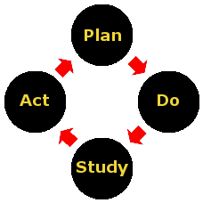
Tool for
reflection in the Cycle of Inquiry

Slide 29

How can we improve our reflection process so that we will be more focused on how family engagement activities may help improve student outcomes?

Slide 30
Cycle of Inquiry
Use Reflection Sheet and Cycle of Inquiry Worksheet to structure a discussion about a recent family engagement practice focused on the transition to high school.

Slide 31
Planning for Family Engagement This School Year
Resources for Group Planning Time
Planning Calendar
Action planning form
List of possible transition activities
Facilitators in the room are happy to discuss with you

Slide 32

Large Group Sharing

Slide 33

Keep Connected!
Look for monthly e-briefs
District facilitator is glad to meet with your team at your school
Stay tuned for date and time for regional cluster meetings

