Slide 1


Improving 9th Grade Student Outcomes
The Why, What and How of Secondary Family Engagement

Slide 2
WHY?
Why 9th grade matters?
Ensuring positive outcomes for all students

Slide 3


“This is the year that will set the stage for whether high school students will graduate and whether they will be ready for college.”
Chicago Consortium on School Research, 2007

Slide 4
Passing All Courses in 9th Grade Is Crucial
Number of Courses Failed in 9th Grade

Slide 5
Percent Graduating on Time, by 9th Grade Attendance Rates
(From Another Urban District)
Success in High School is
Directly Related to Attendance
95% Attendance means missing no more than one day per month.

Slide 6
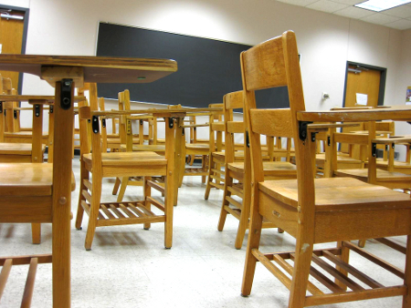
Passing Courses Is Related to Attendance
Students who are chronically absent are much more likely to fail courses than those who attend regularly.

Slide 7
Family Engagement is Critical to Ensure Good Attendance and Course Performance
But research shows that at this critical transition to high school
School efforts to engage families tend to go down

Slide 8


School efforts
to engage families
in the transition to high school
are crucial for
eliminating the opportunity gap.

Slide 9
WHAT
What do families need to know so they can help students be successful in high school?

Slide 10

Small groups brainstorm together

Slide 11

Large Group Sharing

Slide 12
WHAT FAMILIES NEED TO KNOW
Graduation requirements
Required 9th grade classes and required classes for college
How 9th grade math or foreign language placement determined
Who to contact for specific questions
How students can make up missed work during absence
What resources are available to help students with coursework/homework
Information about career and technical education options during high school and required prerequisites
How do students recover credits from failed courses

Slide 13
CAN FAMILIES FIND INFOR-MATION EASILY?
Ask yourselves:
Is it easy for 9th grade parents to find all the information they need?
How do you find out what parents need?

Slide 14

Small Group Discussion about Families’
Information Needs
This Photo by Unknown Author is licensed under CC BY-NC-ND

Slide 15

Communicating with Parents/Families
Know your audience, study your school enrollment statistics for home language, race/ethnicity.
Honor culture and race – use interpreters and translators
Use the language of partnership and reflect it in the school environment
Empower parents with knowledge (e.g., about high school graduation, college/career planning)
Ensure that families know the important role they play in the education and future of their students
Appreciate parent/families’ contribution to their students’ success

Slide 16
Characteristics of Effective Communications
Two-way: school-home-school communications
Focus on positive messages
Anticipate what parents need
Solution focused
Point persons for parents to contact at the school
Responsive to cultures and interests of parents
Share clear expectations of learning goals with families

Slide 17
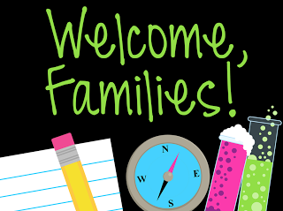

HOW CAN SCHOOLS ENGAGE FAMILIES
Events
Integrated Practices for Those Who Cannot Attend Events
Teachers
Involve
Parents in
Schoolwork
Johns Hopkins University

Slide 18
HOW CAN SCHOOLS ENGAGE FAMILIES
Discussion of Transition-Focused Events
Alumni Family Panel (sharing about transition to HS with current 8th grade families)
Info for 8th Grade Families about HS Course Selection (including HS counselors/administrators)
8th Grade Promotion (including info and guidance about transition to HS)
9th Grade Family Welcome/Orientation
9th Grade Family Meeting After Quarter 1 Progress Reports

Slide 19
Communicating with Families Who Cannot Attend Events
Strategic Use of Website – What is not in your website?
School APP (Schoolinfoapp.com)
Videos – can be posted on school app
Parent Portal – A great tool! Do your parents know how to use it? Who is using it?
Interactive Family Assignments

Slide 20
Interactive Family Assignments
Research-based practice that has shown positive effects on student achievement in core subjects
One way to get information to families who cannot attend events
Promotes interaction between family member and student about what it takes to be successful in high school
Interactive Homework Can Communicate
Information to Families

Slide 21
Four Interactive Activities Focused on Transition
Absences Add Up
Destination Graduation: Stay in the Passing Lane
Gaining Powerful Advantage with a Good GPA
READY, SET, GO on to High School

Slide 22
Time for Feedback
Use the “Search and Discover” feedback sheet with a partner from another level school (8th grade school representative working with 9th grade school representative) to evaluate ONE of the interactive family activities.
How would you adapt this to make it most useful to you and your families?

Slide 23
LUNCH

Slide 24
A Continuous Improvement Approach to Family Engagement

Slide 25
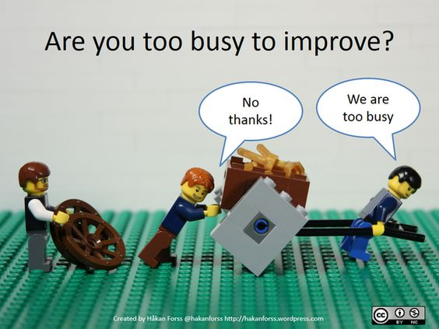
https://www.pinterest.com/pin/551268810610926516/

Slide 26
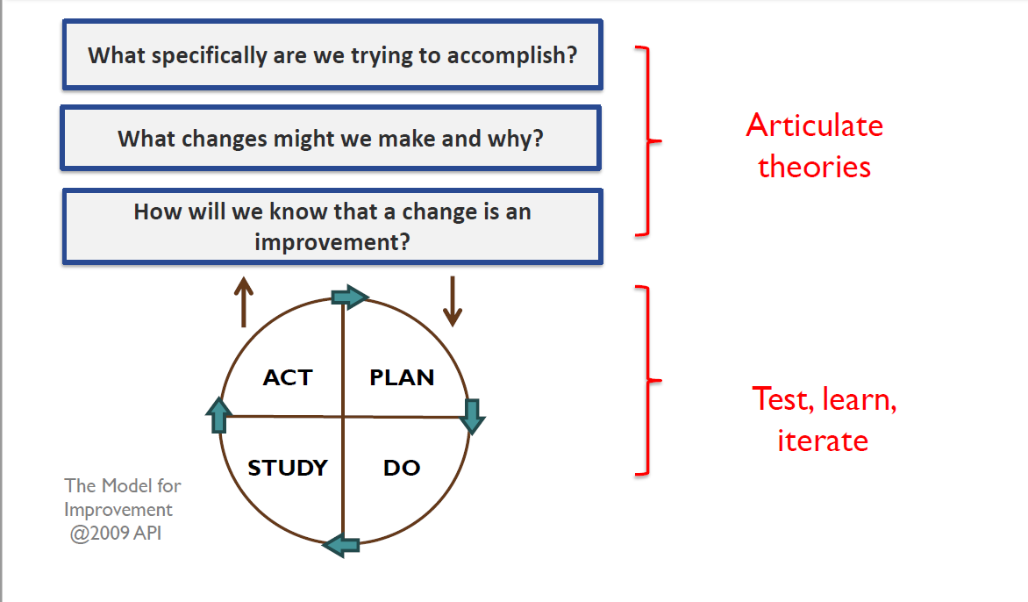
Cycle of Inquiry
A Framework for Continuous Improvement
Cycle
of
Inquiry
Notes:
A key foundation of understanding of my presentation is a general understanding of the Cycle of Inquiry Process: this is consistent with the AWSP, Danielson, and Keeping our Promise Action Plan which cycles of inquiry require a disciplined approach to thinking, questioning, and acting all of which is consistent with the Keeping our Promise Action Plan (explicit connections to what we are already doing, learning).
In relation to the Promise Action Plan, Cycles of Inquiry work is aligned to creating a systemic approach to aligning gap closing strategies into an effective, coherent, system-wide approach (the case for urgent action). A cycle of inquiry approach to adult learning centered on outcomes for all students, specifically traditionally marginalized and underperforming populations is a systems-wide response of the Action Plan.
The parts of the Cycle of Inquiry Process are highlighted here: Starting with a problem of practice, developing a theory of action, collecting and using evidence of progress, taking action, and understanding what happened.
Honig and Ishimaru, 2013

Slide 27
Cycle of Inquiry
Use Reflection Sheet and Cycle of Inquiry Worksheet to structure a discussion about a recent family engagement practice focused on the transition to high school.

Slide 28


Beyond Random Acts of Family Engagement…
Schools need a
SYSTEMATIC
PLAN
linking family engagement
to desired student outcomes

Slide 29
Family Engagement as Part of the School Improvement Plan
The family engagement action plan should be a sub-section of the school improvement plan (it’s not another plan).
How will the school engage families to help meet its goals for student outcomes?
How will all family engagement activities relate to improving outcomes for students in all important areas (attendance, achievement, health, citizenship, college and career readiness, etc.)?

Slide 30
Link Family Engagement to School Improvement Goals
Consider how to plan family engagement strategies and activities that are linked to overarching goals in your school’s improvement plan
CONSULT YOUR
School
Improvement
Plan

Slide 31
What will help us to plan?

Slide 32
Planning for Family Engagement This School Year
Resources for Group Planning Time
Planning Calendar
Action planning form
List of possible transition activities
Facilitators in the room are happy to discuss with you

Slide 33
Large Group Sharing

Slide 34

Keep Connected!
Look for monthly e-briefs
District facilitator is glad to meet with your team at your school
Stay tuned for date and time for regional cluster meetings

