Slide 1
Engaging Families in High School Success
Networked Learning Community Meeting

Slide 2
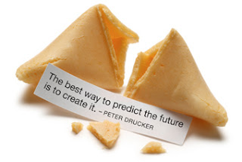
Family engagement fortune cookies
Use the strips provided to write one or more fortune cookie proverbs about family engagement or the process of planning and implementing family engagement activities to share with the group

Slide 3

Families are our greatest allies for student success.

Slide 4

Many hands on the team make lighter work for all.

Slide 5

“We do not learn from experience … we learn from reflecting on experience.”
John Dewey

Slide 6
Keeping our focus on improving attendance and course passing

Slide 10
What might account for decline in 9th grade course failure?
Could it be related to family engagement efforts? Or is it due more to other factors?

Slide 11

Time to Look at latest data at School Level

Slide 12

Sharing effective practices for Spring HS information events for incoming 9th grade families

Slide 13

How can high schools plan ahead to engage families whose children have already shown signs of struggling in 8th grade?

Slide 14
Group Discussion
Text messaging
Parent portal (Source/Schoology/other school portal)
as family engagement strategies
See questions on handout

Slide 15

Writing “Prediction” Fortunes:
By next year our school will …

Slide 16




