Slide 1

The parent portal is a tool for students and their families to:
  Monitor students’ attendance
  Monitor progress in their courses
  Track missing assignments
  And more

Slide 2
Example Slides from
Seattle Public Schools that
Can Be Adapted for Your District

Slide 3
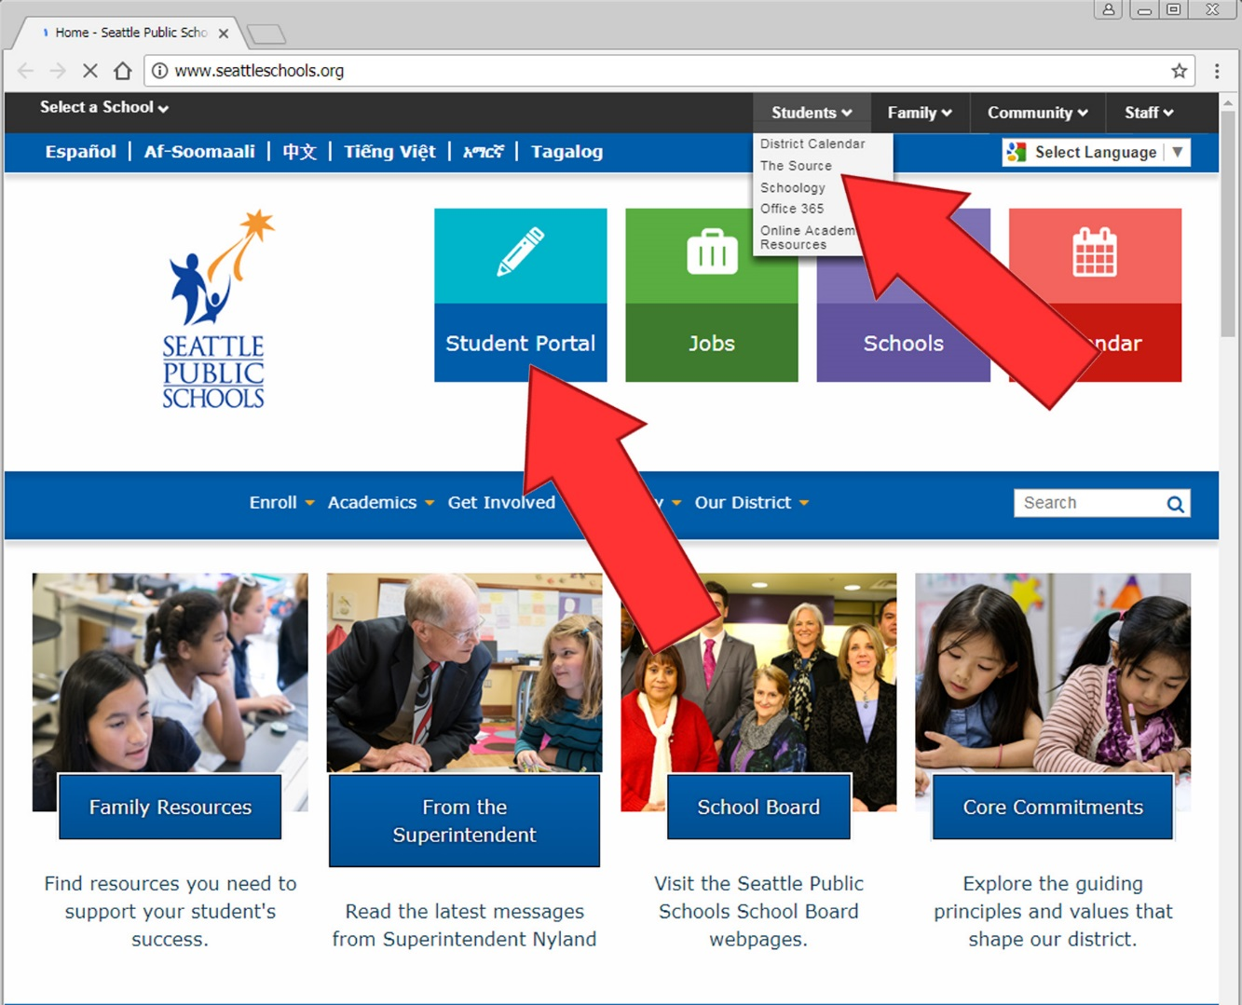
Start at seattleschools.org.
To access The Source, go to the student portal, or choose The Source from the Students drop-down menu:

Slide 4
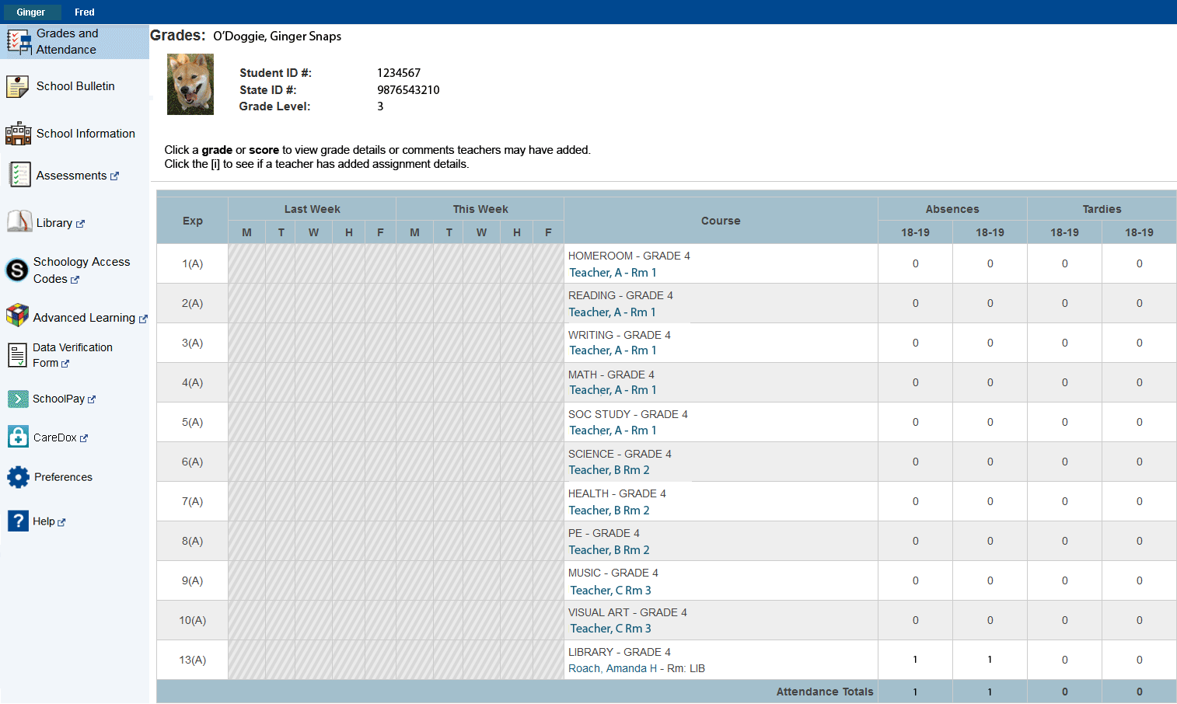
After you log in, you will see a page that looks like this for Elementary Students:
Elementary assignments and grades are not displayed on the Source.

Slide 5
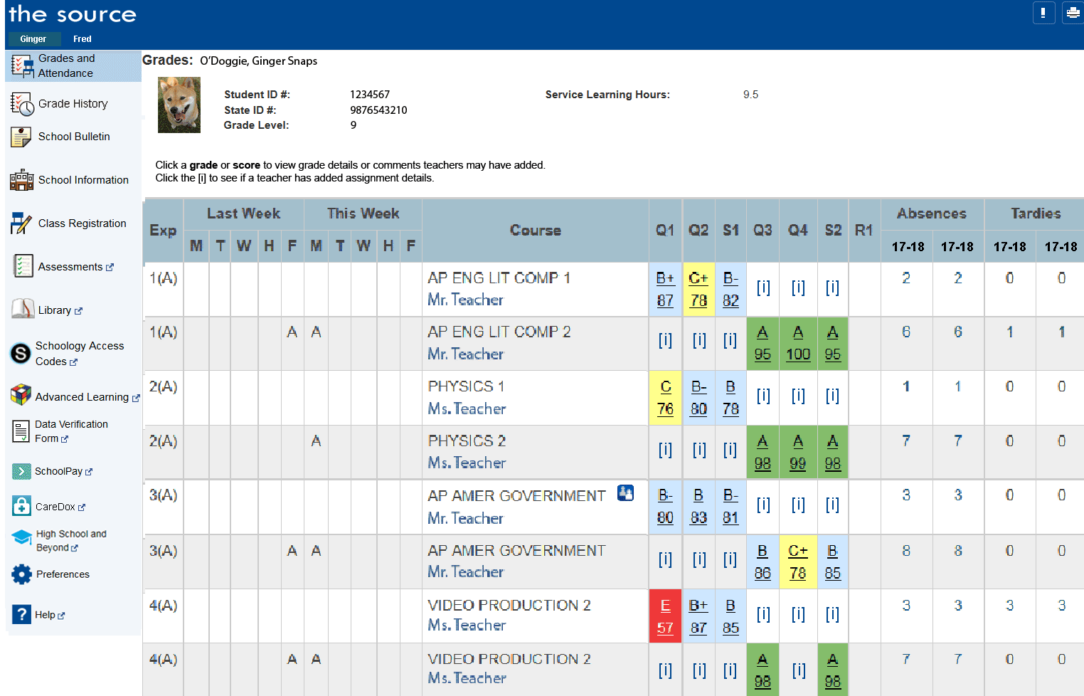
Secondary (Middle and High School) Student Example:

Slide 6
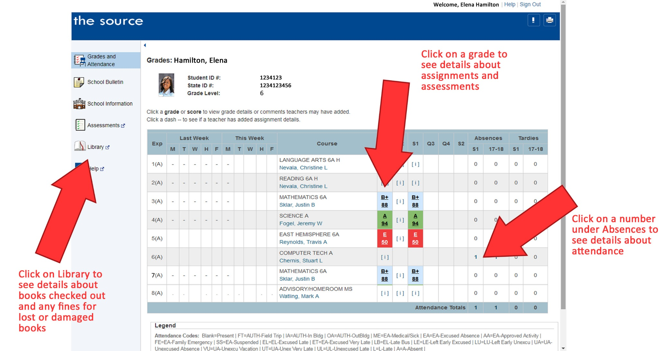

Slide 7
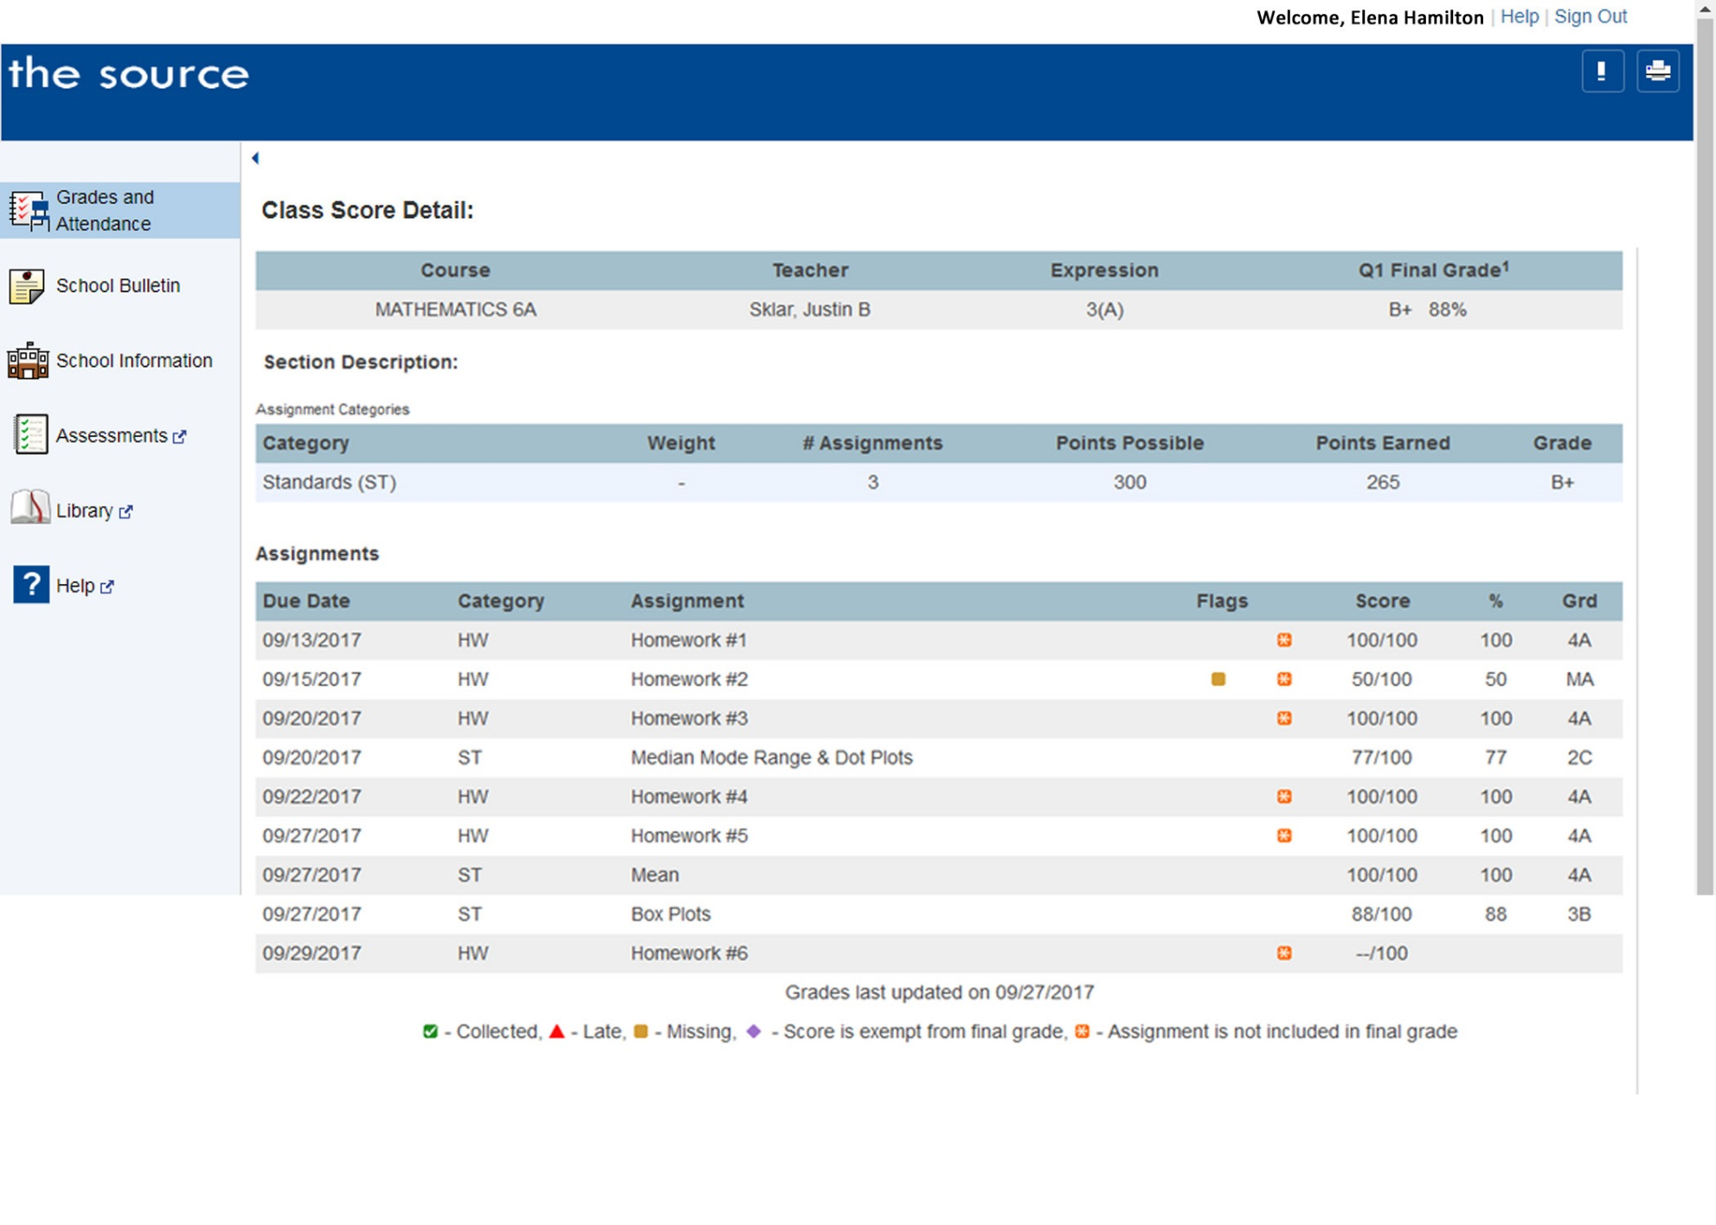
Grade details:

Slide 8
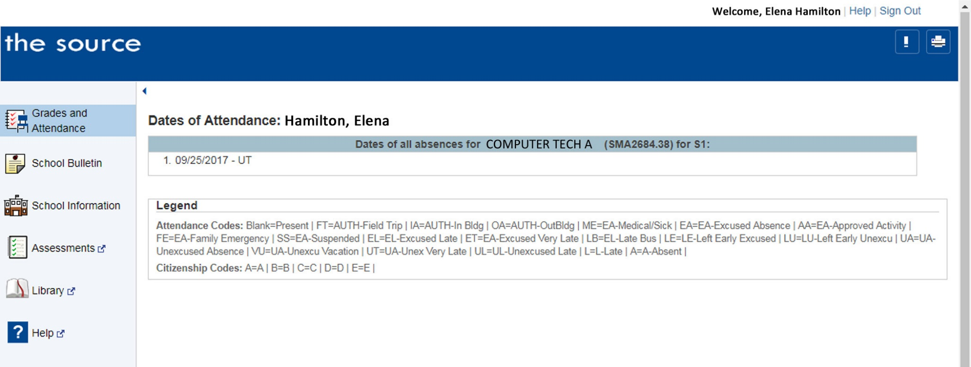
Attendance details:

Slide 9
Secondary (Middle and High School) Student Example:

Slide 10
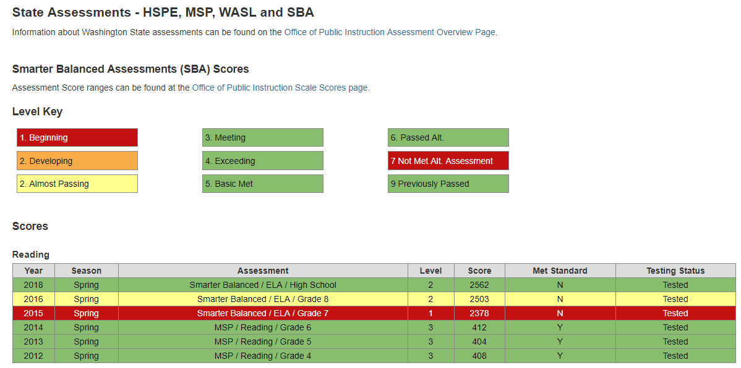
To View Assessment Scores:
If your student successfully completed the MAP, State, End of Course and/or WELPA assessments while attending SPS, you may find their scores on the Source.
Click Assessments from the left menu.
Using the links or drop-down menu, select the assessment you wish to view.
Click Close Window when you are done.

Slide 11

Setting up a Source Account

Slide 12
1. Do you know what email address you have on record for each of your children?
If no, contact your child’s front office person to find out or to change it. Or if you have children in more than one school, contact
Enrollment Services at 206-252-0760 to make sure you have registered the same email address for each of your children.
2. Check to make sure that you are on record as the parent or guardian of each of your children.

Slide 13
Start at www.seattleschools.org
To access The Source, go to the student portal, or choose The Source from the Students drop-down menu:

Slide 14
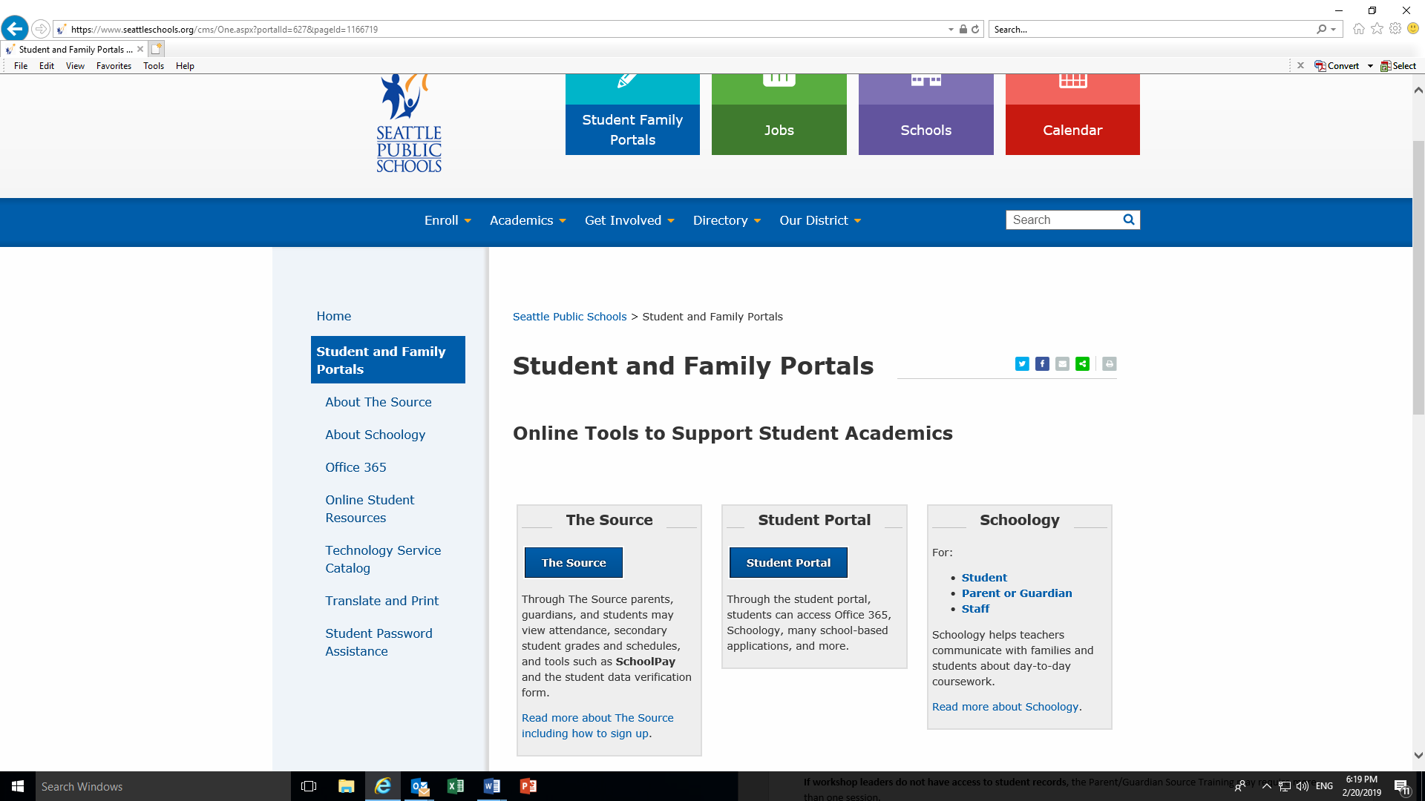
3. Click on “The Source”

Slide 15
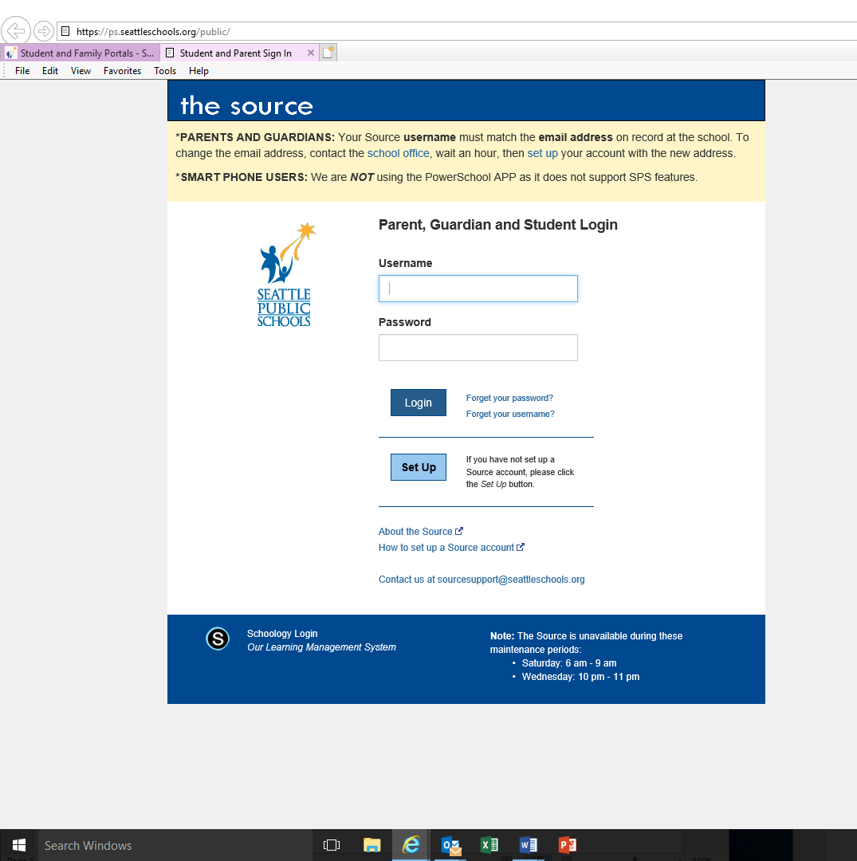
4. If you do not already have a Source account, click on “Set Up”
Before you setup a Source account:
You must be on record as the parent or guardian of a student enrolled in SPS.
Your email address must be on record at each student's school.
Please make sure you have provided the same email address for each SPS student in your family.

Slide 16
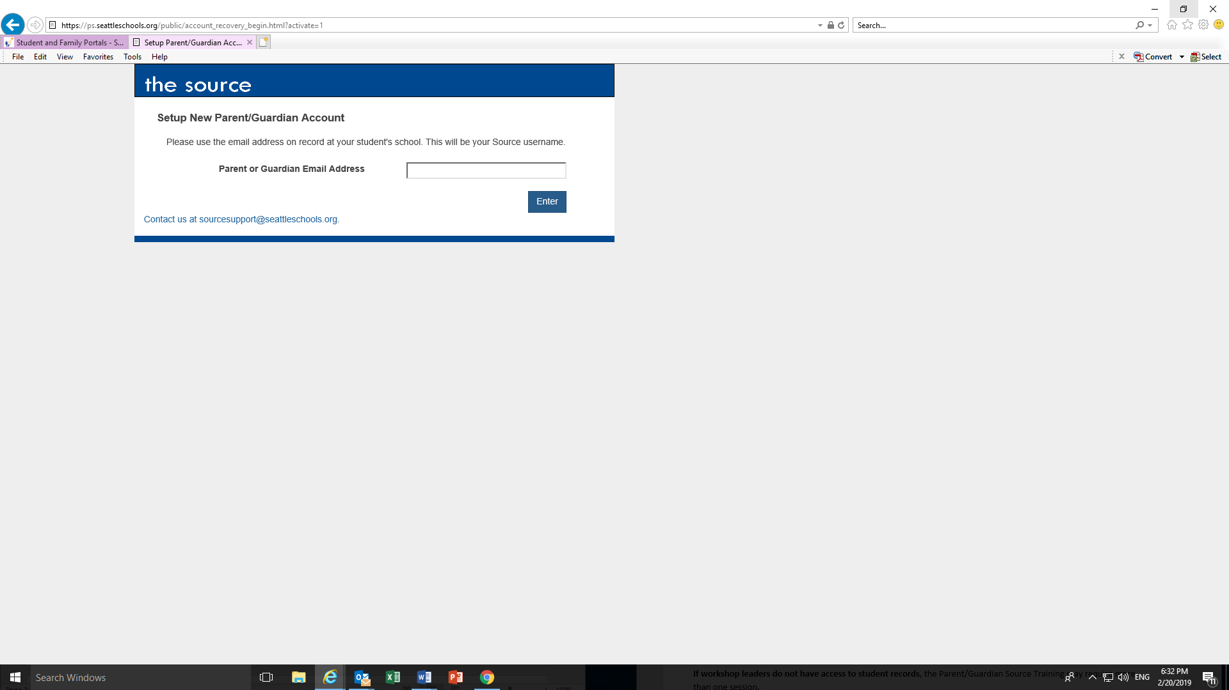
To Set Up a Source Account:
Type the email address on record at your child’s school (it should be the same email address for each of your children), then click “Enter”

Slide 17
---Check your email for a message from sourcesupport@seattleschools.org
If you don’t receive an email from Source Support:
-Check your Spam or Trash folders
-Contact the school(s) to provide your email address.
---Open the email and click the link.
---Enter your Username (the email address on record at the school) and create a Password.
-Your password must be 5 or more characters long.
-Please do not use an apostrophe’ in your password.
Click Enter to begin exploring the Source!
For assistance, please contact sourcesupport@seattleschools.org

Slide 18
If you don't have an email address:
There are many ways to get a free email account. Google's Gmail is free and has a translation feature. Please visit the Create your Google Account website if you would like a Gmail account. To translate the Google Gmail page, scroll to the bottom of the page. Click the drop down on the bottom right to select your language.

Slide 19
How to Create a Hotmail Account
Open the Microsoft Outlook website. Go to https://www.outlook.com/ in your web browser.
Click Create account. It's a link in the top-right side of the page.
Create your email address. Type your preferred email name into the "New email" text field in...
Enter a password. Type the password that you want to use into...
How to Create a Hotmail Account: 8 Steps (with Pictures ... www.wikihow.com/Create-a-Hotmail-Account

Slide 20
For assistance, please contact sourcesupport@seattleschools.org

