Slide 1

Engaging Families in High School Success
Pursuing Continuous Improvement
in our Family Engagement Work

Slide 2

WELCOME!!!
Please introduce yourselves at your tables. Each person should briefly share one FAMILY ENGAGEMENT SUCCESS or encouraging sign from this year.

Slide 3
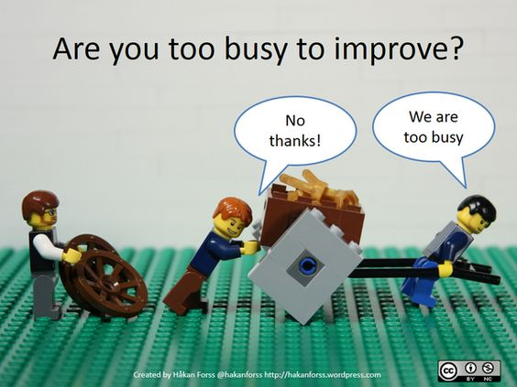

Slide 4
Today’s Goal:
Understand student challenges in 9th grade
Collaboratively begin to engage in a cycle of inquiry process around a possible change idea that could potentially improve student course grade outcomes.

Slide 5

What does research tell us about student success in high school?

Slide 6
Percent Graduating on Time, by 9th Grade Attendance Group
(Data from an Urban District)
Success in High School is
Directly Related to Attendance
95% Attendance means missing no more than one day per month.

Slide 7
Passing All Courses in Ninth Grade Is Crucial
Number of Courses Failed in 9th Grade

Slide 8
Course Failure Is Related to Attendance…

Slide 9
But Even Many With Good Attendance Are Failing
But Even Many with Good Attendance Are Failing
One Quarter of 9th Graders Who Failed at Least One Course Attended at Least 95%
Nearly Half of 9th Graders Who Failed at Least One Course Attended at Least 90%

Slide 10
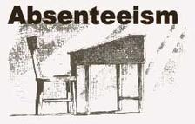
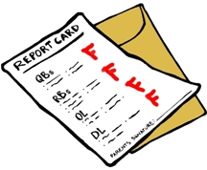
Problem of Practice
f Practice
High rates of
chronic absenteeism
and course failure in 9th grade
Negative impact on graduation rates and postsecondary success

Slide 11
Cycle of Inquiry Process
Applying the
Cycle of Inquiry process
to improve Family
Engagement in 8th and 9th grades, with the
goal of improving
student outcomes
Understand What Happened
Start with a Problem of Practice
Develop a Theory of Action
Take Action
Plan to Collect and Use Evidence of Progress
Honig and Ishimaru, 2013
Notes:
A key foundation of understanding of my presentation is a general understanding of the Cycle of Inquiry Process: this is consistent with the AWSP, Danielson, and Keeping our Promise Action Plan which cycles of inquiry require a disciplined approach to thinking, questioning, and acting all of which is consistent with the Keeping our Promise Action Plan (explicit connections to what we are already doing, learning).
In relation to the Promise Action Plan, Cycles of Inquiry work is aligned to creating a systemic approach to aligning gap closing strategies into an effective, coherent, system-wide approach (the case for urgent action). A cycle of inquiry approach to adult learning centered on outcomes for all students, specifically traditionally marginalized and underperforming populations is a systems-wide response of the Action Plan.
The parts of the Cycle of Inquiry Process are highlighted here: Starting with a problem of practice, developing a theory of action, collecting and using evidence of progress, taking action, and understanding what happened.
Honig and Ishimaru, 2013

Slide 12
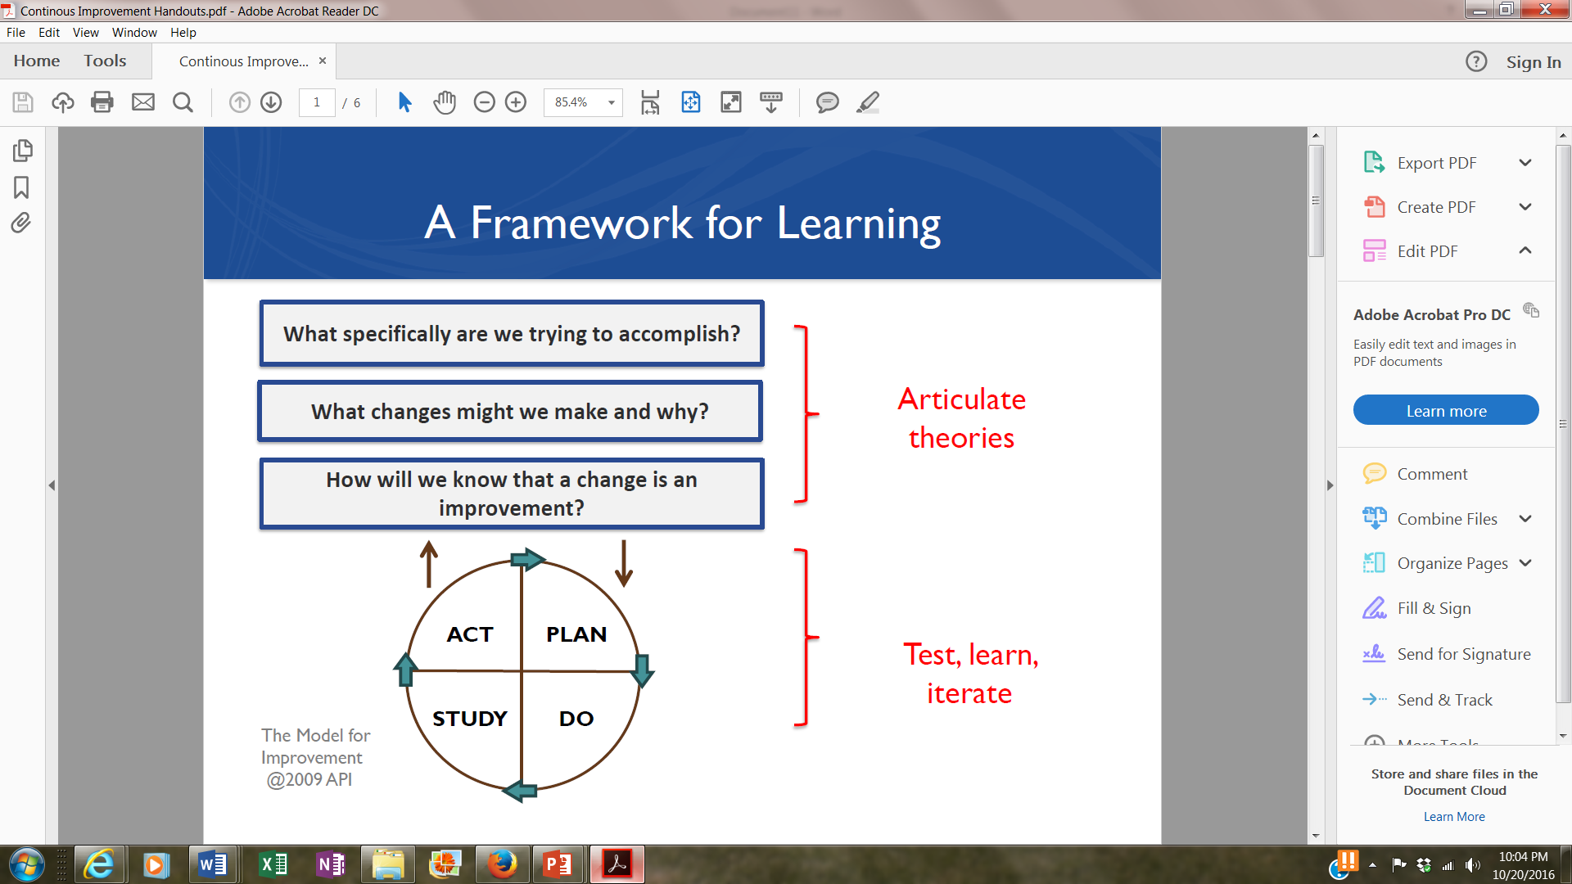
Cycle of Inquiry
A Framework for Continuous Improvement
Cycle
of
Inquiry

Slide 13
Theory of Action
There is evidence that providing families with information about their student’s progress in a timely way can help to improve outcomes.
What change ideas could the school try to improve the transmission of information to families?

Slide 14
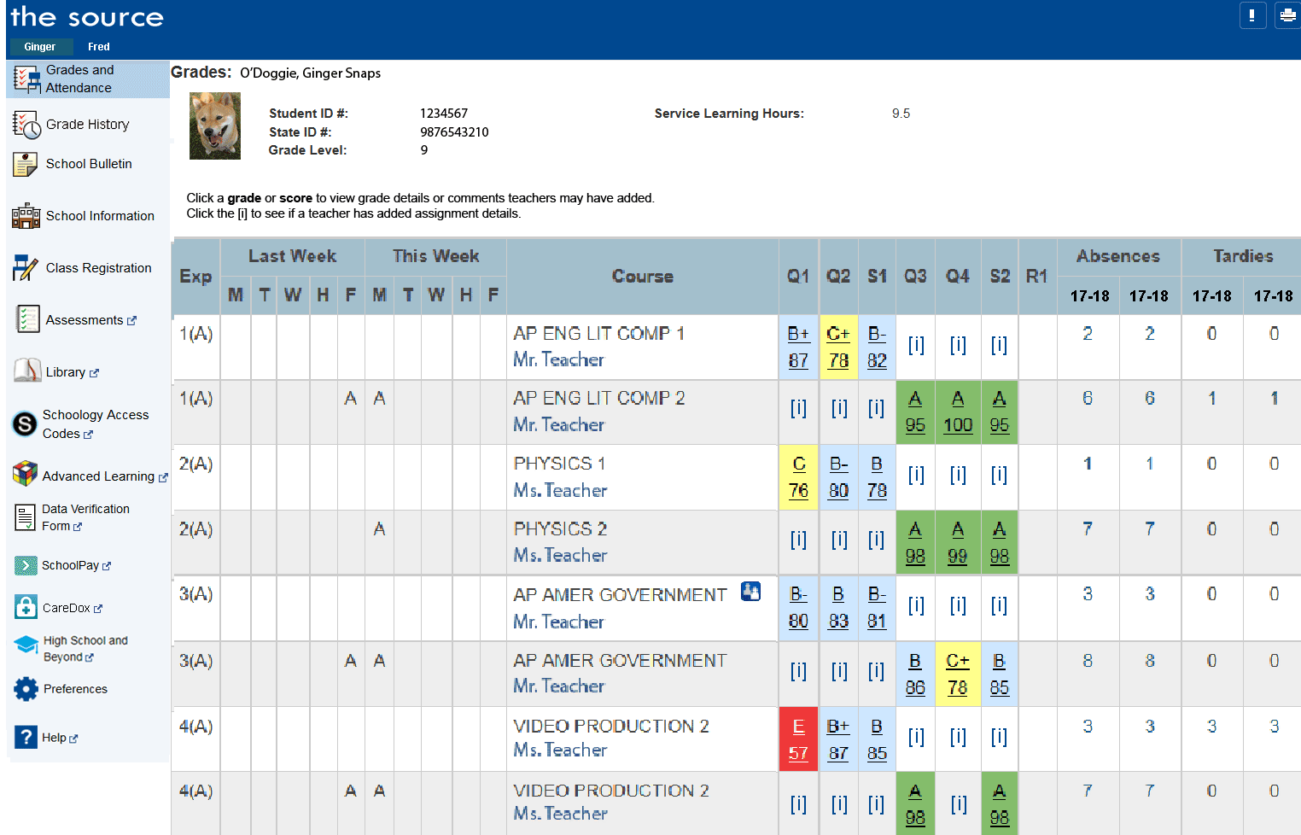
Could increasing families’ access to the parent portal help
to increase parental monitoring of coursework and
thereby improve course passing rates? How can the school
encourage and provide help to parents to access the portal?

Slide 15
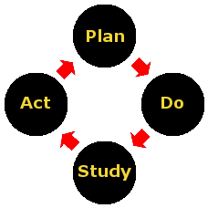
Applying Cycle of Inquiry Process to Family Engagement
Cycle of Inquiry Reflection on Family Engagement Activities Related to the School’s Parent Portal

Slide 16
PDSA
Plan-Do-Study-Act
Cycle of Inquiry Process
PLAN
  We plan to:
  We hope this produces:
  Steps to execute:
DO
  What did you observe when you did this?
STUDY
  What did you learn? Did you meet your goal?
ACT
  What did you conclude from this cycle? What changes might you attempt in the next cycle?

Slide 17
Schools Begin the Process of Planning in Their Cycles of Inquiry

Slide 18





Slide 19
District Facilitator will check in with you in the next month to see how plans are progressing and what school teams have observed in the process.

Slide 20

Keep Connected!
Look for monthly e-briefs
District facilitator is glad to meet with your team at your school
Stay tuned for date and time for regional cluster meetings

Slide 21
THANKS FOR COMING!

