Slide 1


Present-Infrastructure building
Networked Learning Community Meeting

Slide 2



Slide 3

What is a
Networked Learning Community Meeting?

Slide 4

Agenda
How Are We Learning from Families?
What Are We Learning from Our Reflections on our Family Engagement Activities?
Planning for Spring -- Linking Family Engagement Activities to Improving Student Outcomes

Slide 5



How Are We Learning from Families?
2-Way Communication

Slide 6

Opportunities to Learn from Families
Put a post-it on the sheet that represents the number of INDIVIDUAL interactions (NOT BROAD COMMUNICATION WITH ALL FAMILIES) you have had with family members of students at your school in the past month – since the beginning of 2019.
Communications can be: Email, Text, Phone, Face to Face
None
1-20
21-40
41-60
More than 60

Slide 7

Modes of Communication with Individual Family Members
Now put a post-it on each MODE of communication you have had with individual family members of students at your school in the past month:
Email
Text
Phone conversation
Face to Face
Other (specify)

Slide 8

Topics of Communication with Individual Family Members
Now write on different post-its each particular TOPIC of communication you have had with individual family members of students at your school in the past month.
(We will group these in overarching themes.)

Slide 9

What are the OVERARCHING themes of communication with individual families?

Slide 10

Possible Themes of
Interactions with Families
Attendance Issues (illness, transportation, family issues, etc.)
Behavior Issues
Grading/Achievement Issues
Safety issues
Student fears, anxieties, etc.
Sports and other extracurricular activities

Slide 11

What have you learned from interactions with families?
How has this helped you to work more effectively with students so that outcomes can improve?

Slide 12





Slide 13

What Are We Learning from Our Reflections on our Family Engagement Activities?

Slide 14
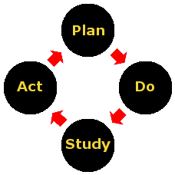
Applying Cycle of Inquiry Process to Family Engagement

Slide 15


School Teams sharing their reflections on a recent family engagement activity

Slide 16
What did you plan?
What was the goal?
How did the goal address student outcomes?
How did your plans reflect learning from the past?
PLAN

Slide 17
What did you observe?
    What did families experience?
    What evidence do you have of how activity helped families?
    What evidence did you see of how activity could help influence student outcomes?
DO

Slide 18
What did you learn?
How does what you observed lead to conclusions about what is needed next to improve family engagement efforts in ways that can lead to improved student outcomes?
STUDY

Slide 19
What did you conclude that will influence your planning for future family engagement activities (not necessarily just the same activity next year)?
ACT

Slide 20
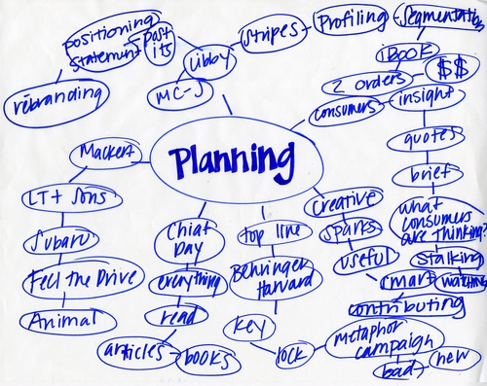
What are you planning?
What have you learned from past experience that will influence what you do this year?
What questions do you have for your colleagues?

Slide 22

Please complete the exit ticket with feedback for us

